Slide 1
Blaze Control

Slide 2
BLAZE CONTROL
01
02
OUR TEAM
OUR IDEA
03
04
PLANNING STAGES
TECHNOLOGIES

Slide 3
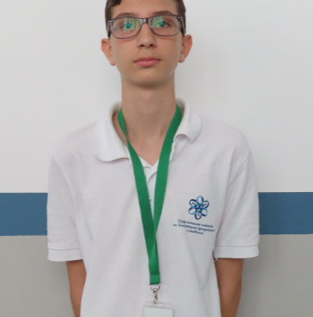
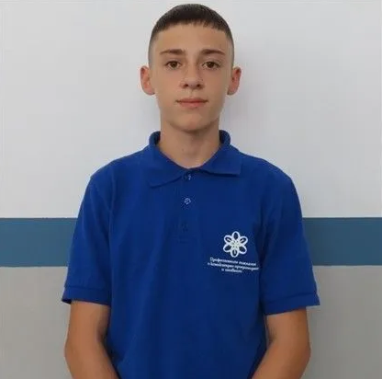
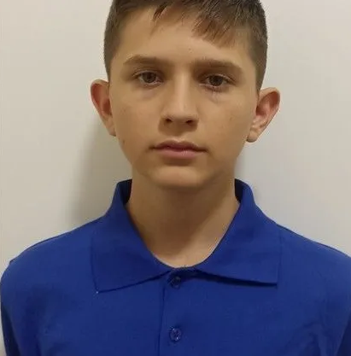
MEMBERS
Victor Nikolov 9v
Grigor Sacharov 9a
Asen Kokalarov 9g
-scrum trainer-
-back-end developer-
-front-end developer-

Slide 4

OUR IDEA
Our idea:Our idea is to create an informative and easy-to-use website about fire services in Bulgaria. It will include:
Types of firefighting vehicles
Firefighters and their roles
Real incidents and responses
An interactive map showing fire station locations
The goal is to educate the public, promote fire safety, and highlight the hard work of emergency responders.

Slide 5





TECHNOLOGIES

Slide 6
NOW LETS MOVE TO OUR PROJECT

